Slide 1
UNIT 2

Slide 2
Block cipher principles
Block ciphers are built in the Feistel cipher structure. Block cipher has a specific number of rounds and keys for generating cipher text. Block cipher is a type of encryption algorithm that processes fixed-size blocks of data, usually 64 or 128 bits, to produce cipher text. The design of a block cipher involves several important principles to ensure the security and efficiency of the algorithm. Some of these principles are:

Slide 3
1.Number of Rounds – The number of Rounds is regularly considered in design criteria, it just reflects the number of rounds to be suitable for an algorithm to make it more complex, in DES we have 16 rounds ensuring it to be more secure while in AES we have 10 rounds which makes it more secure.

Slide 4
2.Design of function F – The core part of the Feistel Block cipher structure is the Round Function. The complexity of cryptanalysis can be derived from the Round function i.e. the increasing level of complexity for the round function would be greatly contributing to an increase in complexity. To increase the complexity of the round function, the avalanche effect is also included in the round function, as the change of a single bit in plain text would produce a mischievous output due to the presence of avalanche effect.

Slide 5
3.Key Size: The key size should be large enough to prevent brute-force attacks. A larger key size means that there are more possible keys, making it harder for an attacker to guess the correct one. A key size of 128 bits is considered to be secure for most applications.
4.Key Schedule: The key schedule should be designed carefully to ensure that the keys used for encryption are independent and unpredictable. The key schedule should also resist attacks that exploit weak keys or key-dependent properties of the cipher.

Slide 6
Block Cipher modes of operations
Encryption algorithms are divided into two categories based on the input type, as a block cipher and stream cipher. Block cipher is an encryption algorithm that takes a fixed size of input say b bits and produces a ciphertext of b bits again. If the input is larger than b bits it can be divided further. For different applications and uses, there are several modes of operations for a block cipher.

Slide 7
1.Electronic Code Book (ECB) – Electronic code book is the easiest block cipher mode of functioning. It is easier because of direct encryption of each block of input plaintext and output is in form of blocks of encrypted cipher text. Generally, if a message is larger than b bits in size, it can be broken down into a bunch of blocks and the procedure is repeated.

Slide 8
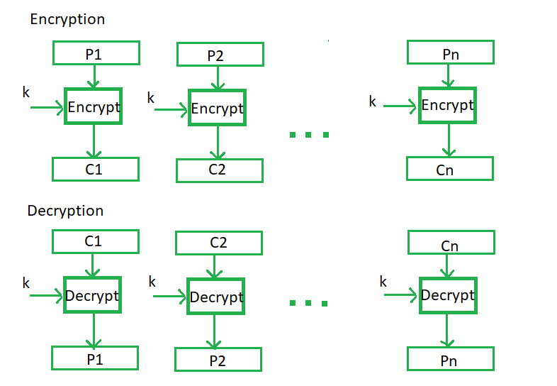

Slide 9
2.Cipher Block Chaining – Cipher block chaining or CBC is an advancement made on ECB since ECB compromises some security requirements. In CBC, the previous cipher block is given as input to the next encryption algorithm after XOR with the original plaintext block. In a nutshell here, a cipher block is produced by encrypting an XOR output of the previous cipher block and present plaintext block.

Slide 10
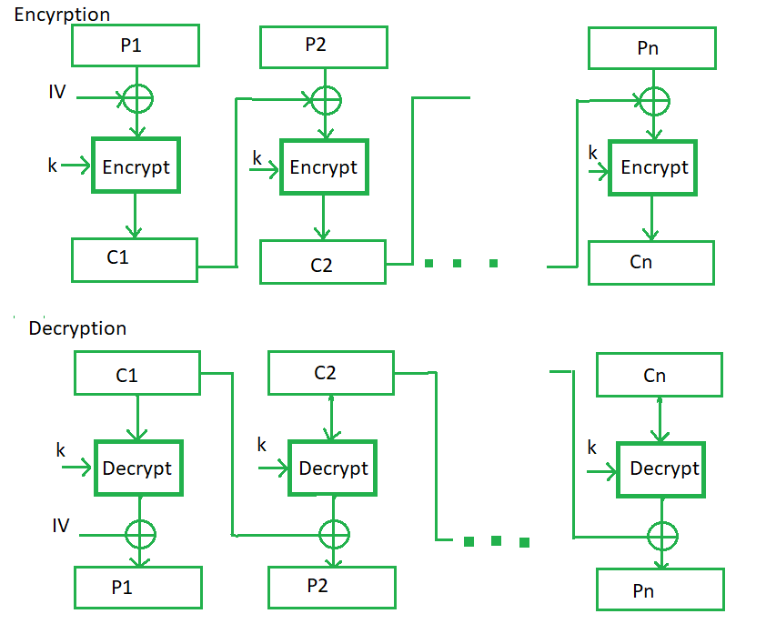

Slide 11
3.Cipher Feedback Mode (CFB) – In this mode the cipher is given as feedback to the next block of encryption with some new specifications: first, an initial vector IV is used for first encryption and output bits are divided as a set of s and b-s bits.The left-hand side s bits are selected along with plaintext bits to which an XOR operation is applied. The result is given as input to a shift register having b-s bits to lhs,s bits to rhs and the process continues. The encryption and decryption process for the same is shown below, both of them use encryption algorithms.

Slide 12
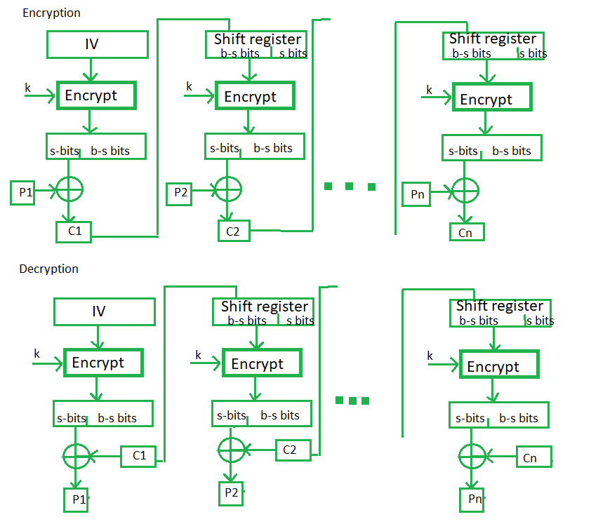

Slide 13
4.Output Feedback Mode – The output feedback mode follows nearly the same process as the Cipher Feedback mode except that it sends the encrypted output as feedback instead of the actual cipher which is XOR output. In this output feedback mode, all bits of the block are sent instead of sending selected s bits. The Output Feedback mode of block cipher holds great resistance towards bit transmission errors. It also decreases the dependency or relationship of the cipher on the plaintext.

Slide 14
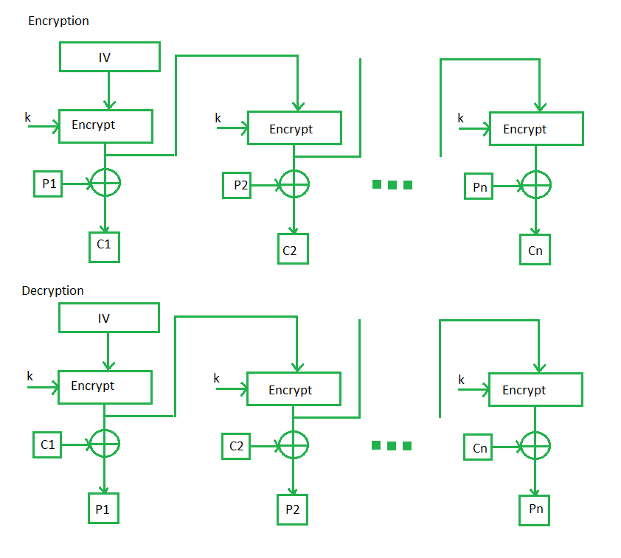

Slide 15
5.Counter Mode – The Counter Mode or CTR is a simple counter-based block cipher implementation. Every time a counter-initiated value is encrypted and given as input to XOR with plaintext which results in cipher text block. The CTR mode is independent of feedback use and thus can be implemented in parallel.

Slide 17
Data Encryption Standard
INTRODUCTION
The Data Encryption Standard (DES) was jointly developed in 1974 by IBM and
the U.S. government to set a standard that everyone could use to securely
communicate with each other. It operates on blocks of 64 bits using a secret key
that is 56 bits long. The original proposal used a secret key that was 64 bits long.

Slide 18
It is widely believed that the removal of these 8 bits from the key was done to
make it possible for U.S. government agencies to secretly crack messages.
DES started out as the "Lucifer" algorithm developed by IBM. The US National
Security Agency (NSA) made several modifications, after which it was adopted as
Federal Information Processing Standard (FIPS) standard 46-3 and ANSI standard
X3.92.

Slide 19
DES (and most of the other major symmetric ciphers) is based on a cipher known as the Feistel block cipher. This was a block cipher developed by the IBM cryptography researcher Horst Feistel in the early 70’s. It consists of a number of rounds where each round contains bit-shuffling, non-linear substitutions (S-boxes) and exclusive OR operations. Most symmetric encryption schemes today are based on this structure(known as a feistel network). As with most encryption schemes, DES expects two inputs - the plaintext to be encrypted and the secret key.

Slide 20
The manner in which the plaintext is accepted, and the key arrangement used for encryption and decryption, both determine the type of cipher it is. DES is therefore a symmetric, 64 bit block cipher as it uses the same key for both encryption and decryption and only operates on 64 bit blocks of data at a time5 (be they plaintext or cipher text).

Slide 21
The key size used is 56 bits, however a 64 bit (or eight-byte) key is actually input. The least significant bit of each byte is either used for parity (odd for DES) or set arbitrarily and does not increase the security in any way. All blocks are numbered from left to right which makes the eight bit of each byte the parity bit.

Slide 22
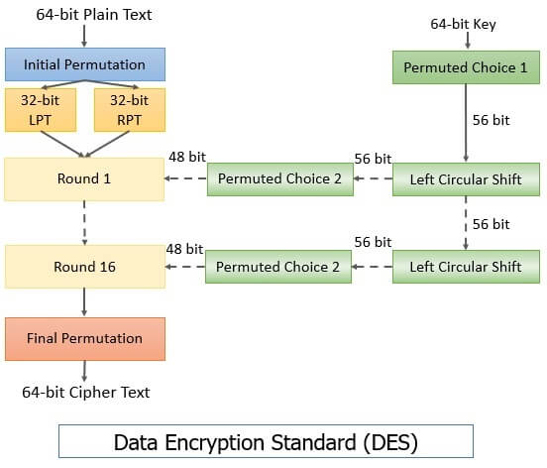

Slide 23
Simplified DES
Simplified Data Encryption Standard (S-DES) is a simple version of the DES Algorithm. It is similar to the DES algorithm but is a smaller algorithm and has fewer parameters than DES. It was made for educational purposes so that understanding DES would become simpler. It is a block cipher that takes a block of plain text and converts it into cipher text. It takes a block of 8 bit.

Slide 24
It is a symmetric key cipher i.e. they use the same key for both encryption and decryption. In this article, we are going to demonstrate key generation for s-des encryption and decryption algorithm. We take a random 10-bit key and produce two 8-bit keys which will be used for encryption and decryption.
Key Generation Concept: In the key generation algorithm, we accept the 10-bit key and convert it into two 8 bit keys. This key is shared between both sender and receiver.

Slide 25
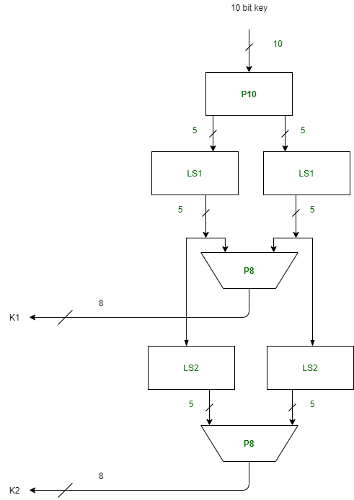

Slide 26
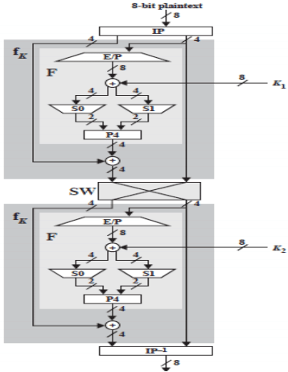

Slide 27


Slide 28



Slide 29


Slide 30



Slide 31
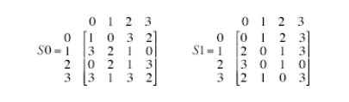

Slide 32
Blow Fish Algorithm
Blowfish is an encryption technique designed by Bruce Schneier in 1993 as an alternative to DES Encryption Technique. It is significantly faster than DES and provides a good encryption rate with no effective cryptanalysis technique found to date. It is one of the first, secure block ciphers not subject to any patents and hence freely available for anyone to use. It is symmetric block cipher algorithm.

Slide 33
block Size: 64-bits
key Size: 32-bits to 448-bits variable size
number of sub keys: 18 [P-array]
number of rounds: 16
number of substitution boxes: 4 [each having 512 entries of 32-bits each].

Slide 34
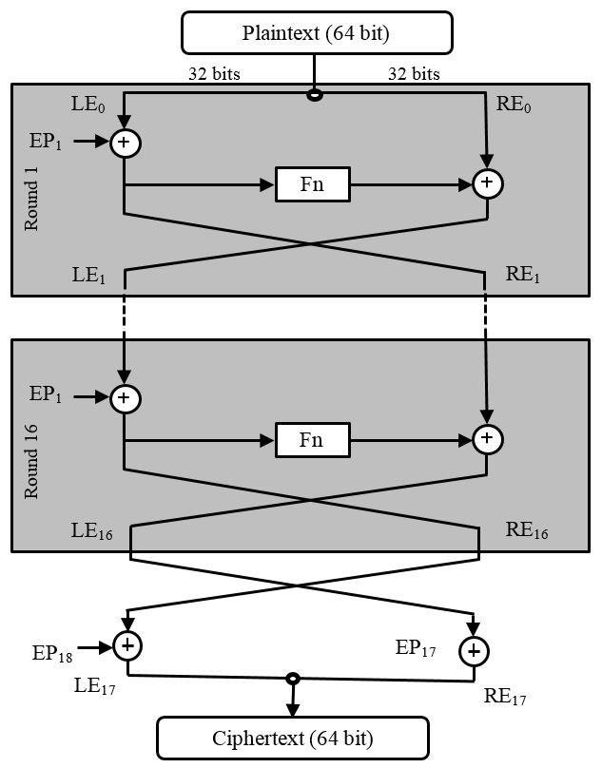

Slide 35
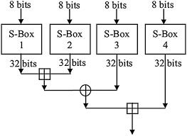
Function F

Slide 36
Advanced Encryption Standard(AES)
Advanced Encryption Standard (AES) is a specification for the encryption of electronic data established by the U.S National Institute of Standards and Technology (NIST) in 2001. AES is widely used today as it is a much stronger than DES and triple DES despite being harder to implement.
Points to remember
AES is a block cipher.
The key size can be 128/192/256 bits.
Encrypts data in blocks of 128 bits each.

Slide 37
That means it takes 128 bits as input and outputs 128 bits of encrypted cipher text as output. AES relies on substitution-permutation network principle which means it is performed using a series of linked operations which involves replacing and shuffling of the input data.
Working of the cipher : AES performs operations on bytes of data rather than in bits. Since the block size is 128 bits, the cipher processes 128 bits (or 16 bytes) of the input data at a time.

Slide 38
The number of rounds depends on the key length as follows :
128 bit key – 10 rounds
192 bit key – 12 rounds
256 bit key – 14 rounds

Slide 39
RC5 Algorithm
RC5 is a symmetric key block encryption algorithm designed by Ron Rivest in 1994. It is notable for being simple, fast (on account of using only primitive computer operations like XOR, shift, etc.) and consumes less memory.
Example:

Slide 40
Key : 00 00 00 00 00 00 00 00 00 00 00 00 00 00 00 00 Plain Text : 00000000 00000000 Cipher Text : EEDBA521 6D8F4B15
Parameter Possible Value
block/word size (bits) 16, 32, 64
Number of Rounds 0 – 255
Key Size (bytes) 0 – 255

Slide 41
Since at a time, RC5 uses 2 word blocks, the plain text block size can be 32, 64 or 128 bits. Notation used in the algorithm:
Symbol Operation
x <<< y Cyclic left shift of x by Y bits
+ Two’s complement addition of words where addition is modulo
^ Bit wise Exclusive-OR

Slide 42
Encryption. We divide the input plain text block into two registers A and B each of size w bits. After undergoing the encryption process the result of A and B together forms the cipher text block. RC5 Encryption Algorithm:
One time initialization of plain text blocks A and B by adding S[0] and S[1] to A and B respectively. These operations are mod.
XOR A and B. A=A^B
Cyclic left shift new value of A by B bits.

Slide 43
Add S[2*i] to the output of previous step. This is the new value of A.
XOR B with new value of A and store in B.
Cyclic left shift new value of B by A bits.
Add S[2*i+1] to the output of previous step. This is the new value of B.
Repeat entire procedure (except one time initialization) r times.

Slide 44
A = A + S[0]
B = B + S[1]
for i = 1 to r do:
A = ((A ^ B) <<< B) + S[2 * i]
B = ((B ^ A) <<< A) + S[2 * i + 1] return A, B
Alternatively, RC5 Decryption can be defined as:

Slide 45
for i = r down to 1 do:
B = ((B - S[2 * i + 1]) >>> A) ^ A
A = ((A - S[2 * i]) >>> B) ^ B
B = B - S[1]
A = A - S[0]
return A, B

